Slide 1

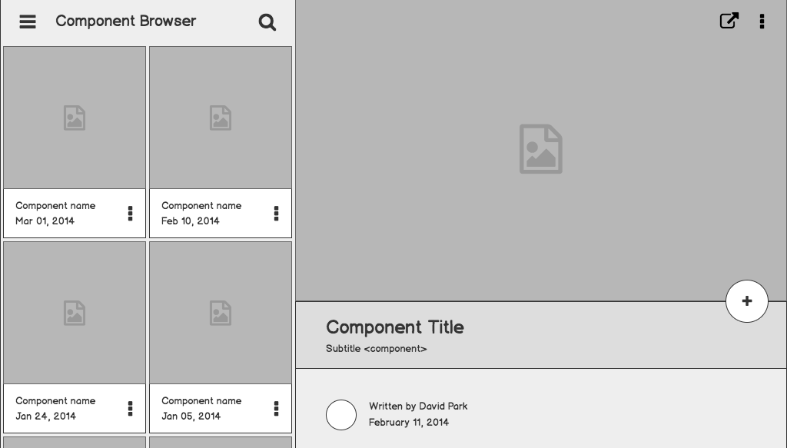

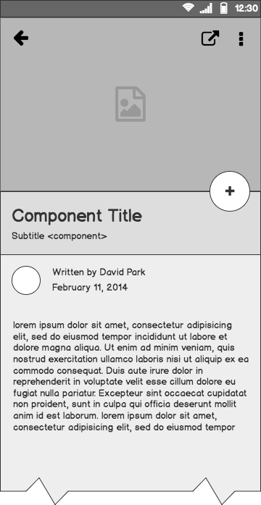
MovieBook
TEAM 12 Deepak Tiwari (2022SP93033)
Vyom Khare (2022SP93063)
Sourabh Rana (2022SP93089)

Slide 2
Outline
PROJECT DESCRIPTION
ARCHITECTURE
SCREENSHOTS
CHALLENGING / INTERESTING POINTS

Slide 3
Project Description
Movie Book provides latest, trending and upcoming movies using TMDb APIs. The App contains all information about movies like - synopsis, cast and etc .
FEATURES :
User authentication with TMDB credentials and a guest login option.
Feedback system for user opinions and issue reporting.
Ability to mark movies as favorites.
Movie categories: popular, trending, and coming soon.
Detailed movie information, including cast and crew.
Search functionality to find any movie.
Integration with the TMDB API for movie data retrieval.

Slide 4
Challenges
Cloudinary integration
IOS simulator was not working
Difficulty in UI animations

Slide 5
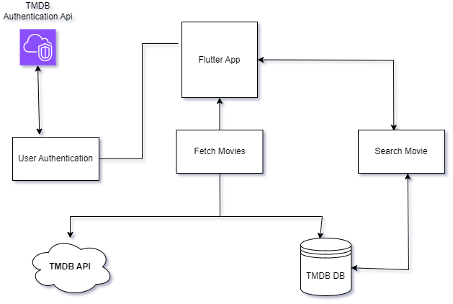

Slide 6
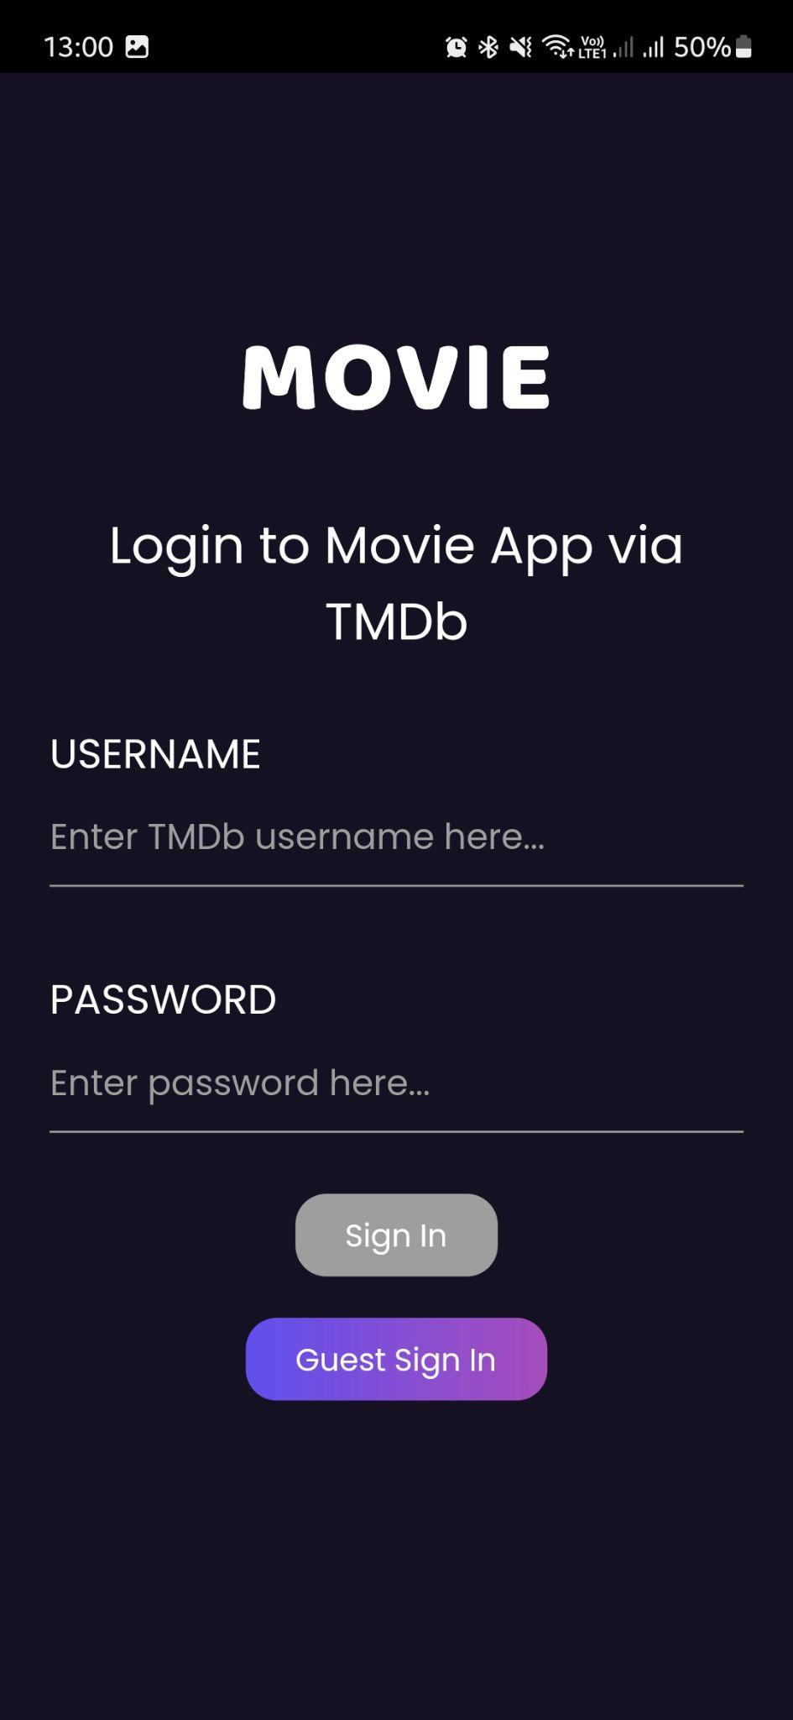
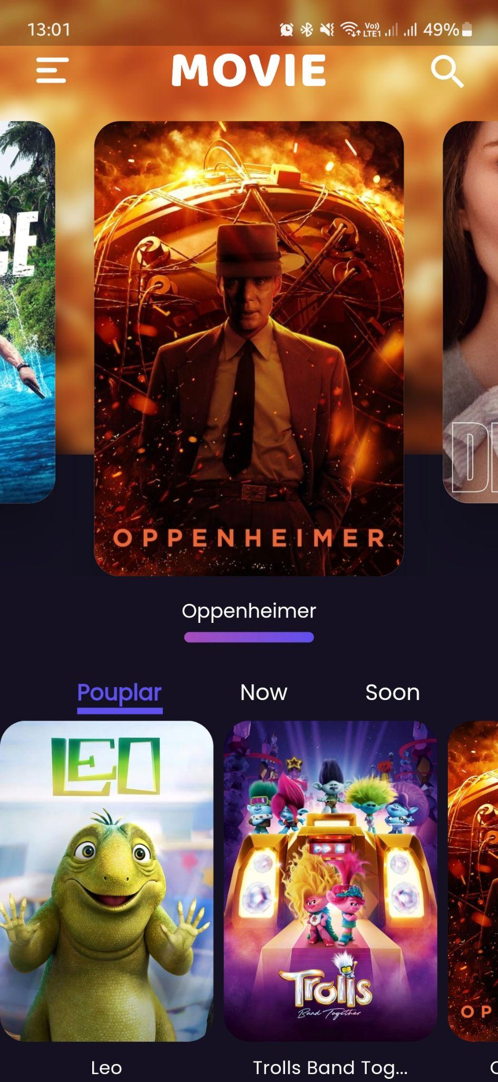
Search functionality
Login via TMDb
Popular, trending and upcoming movies

Slide 7
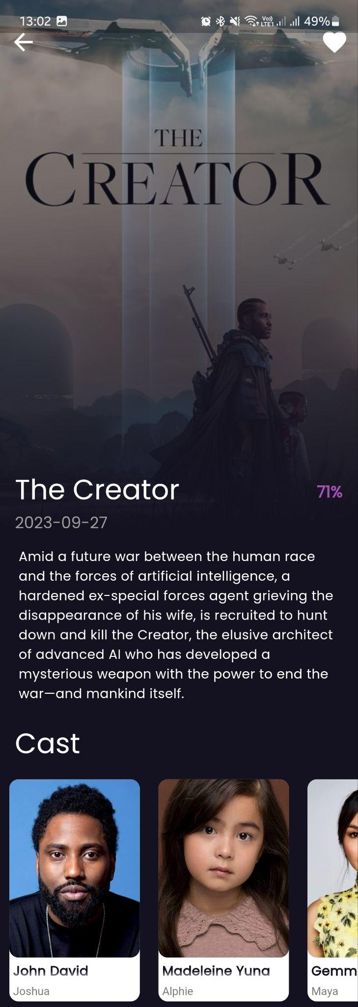
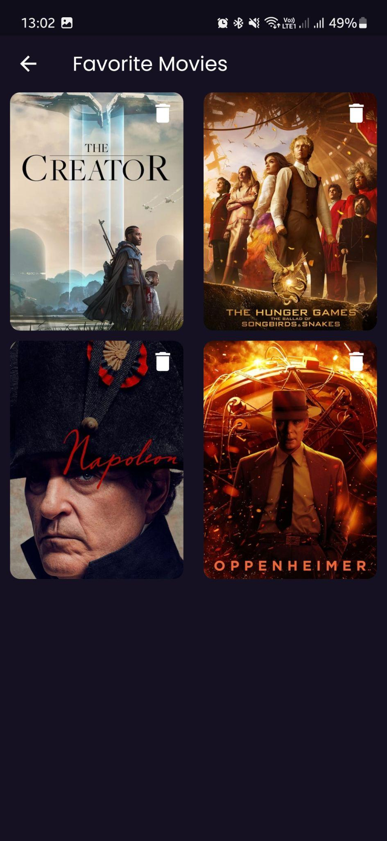
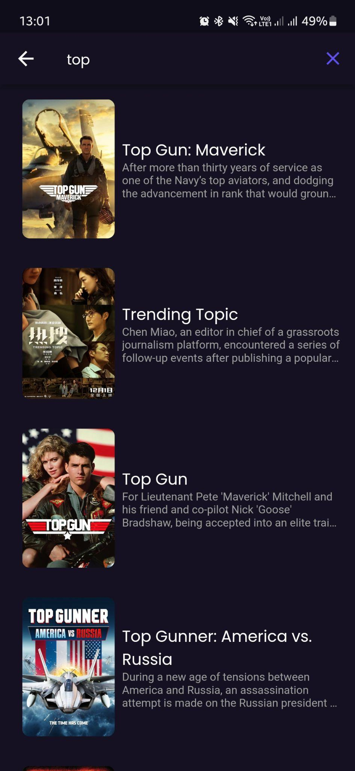
Favourite option
Rating, Title and Synopsis
Cast
Search results
Favourite movies

Slide 8
Challenges/
Interesting points

Slide 9
THANK YOU!

